Slide 1
REGRESSION EVALUATION · LECTURE 3
How Good Is Your Regression Model?
The math and geometric intuition behind five evaluation metrics — MAE, MSE, RMSE, R², and Adjusted R² — plus how to compute each in scikit-learn
Machine Learning • Regression Series

Slide 2
ROADMAP
Five Metrics, Two Families
Three metrics measure how much error a model makes. Two measure how good the model is, relative to a baseline — and we'll build each from the ground up.
ERROR METRICS
GOODNESS-OF-FIT METRICS
MAE
R²
Mean Absolute Error — average of |actual − predicted|
Coefficient of Determination — how much better than guessing the mean
MSE
Mean Squared Error — average of the squared error
Adjusted R²
Corrects R² for the number of input features used
RMSE
Root Mean Squared Error — square root of MSE
Regression Metrics — MAE · MSE · RMSE · R² · Adjusted R²
2

Slide 3
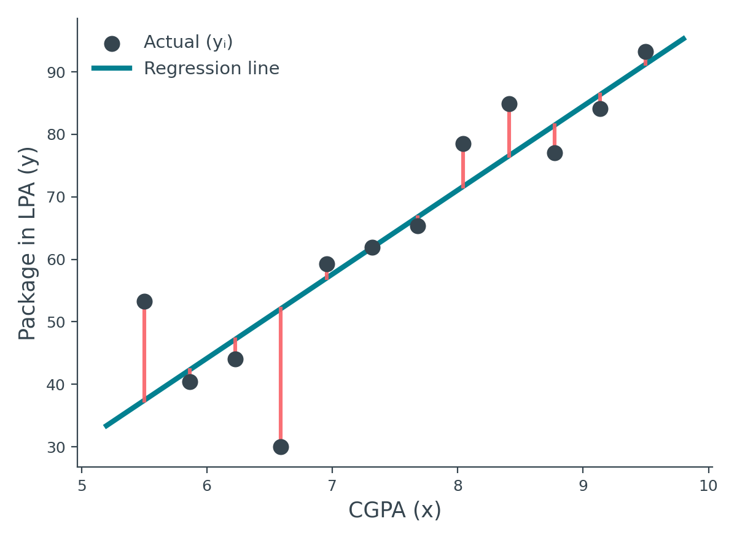
CONTEXT
You Trained a Model — Now What?
Say you fit a Simple Linear Regression line on the placement dataset (CGPA → package). The line exists — but is it any good? These metrics answer that.
The core idea behind every metric on this list
•
Look at every point
For each student, compare the actual package to what the line predicted.
•
Measure the gap
That gap — the residual — is the model's mistake on that one point.
•
Combine all the gaps
Different metrics combine residuals differently — and that choice matters.
Regression Metrics — MAE · MSE · RMSE · R² · Adjusted R²
3

Slide 4
MAE
Mean Absolute Error — The Intuition
For every point, measure the straight-line distance between actual and predicted — ignoring whether the point sits above or below the line.
Why ignore the sign?
Some points sit above the line (positive gap), some below (negative gap). If we add signed differences directly, they cancel out and hide the true mistake.
The fix: take the absolute value
|y₁ − ŷ₁|, |y₂ − ŷ₂|, and so on — every gap becomes positive, regardless of direction.
Regression Metrics — MAE · MSE · RMSE · R² · Adjusted R²
4

Slide 5
MAE
The MAE Formula
Sum the absolute error over every point, then divide by the number of points to get an average mistake per point:
MAE = (1/n) Σ | yᵢ − ŷᵢ | i = 1 to n
n
yᵢ
ŷᵢ
the number of data points (students) you're evaluating on
the actual value for point i, straight from the data
("y-hat") the model's predicted value for point i
Note: the modulus (absolute value) is what removes the sign — this is the one deliberate design choice that defines MAE.
Regression Metrics — MAE · MSE · RMSE · R² · Adjusted R²
5

Slide 6
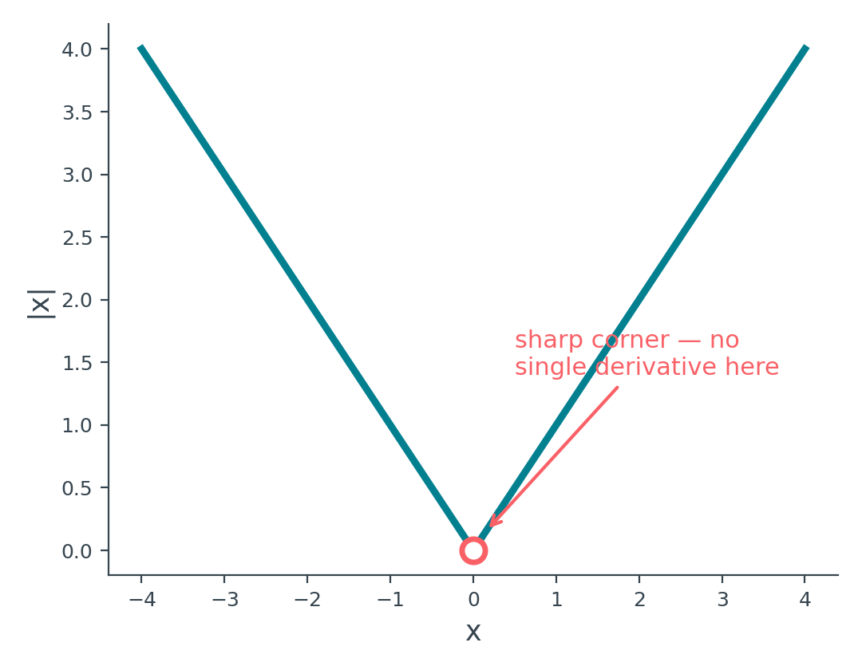
MAE
MAE: Strengths and the One Big Weakness
✓
Same units as y
✓
Robust to outliers
If y is package in LPA, MAE is also in LPA. An error of 1.5 means "1.5 LPA off" — directly communicable to anyone.
Every error contributes in direct proportion to its size — one extreme point can't dominate the total the way it can with squared error.
✕
Not differentiable everywhere
The |x| function has a sharp corner at zero — continuous, but not differentiable there. Optimization techniques like Gradient Descent rely on differentiating the loss function at every step, so a function that breaks at one point is a real obstacle.
Regression Metrics — MAE · MSE · RMSE · R² · Adjusted R²
6

Slide 7
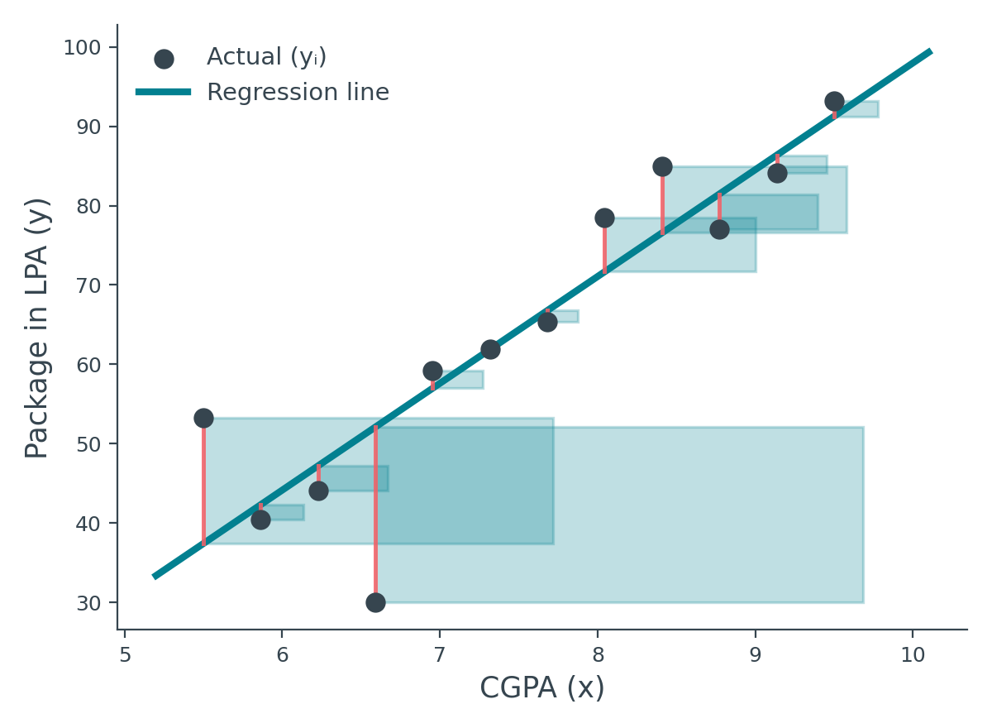
MSE
Mean Squared Error — Square Instead of Absolute
Same starting point as MAE — but instead of taking the absolute value of each residual, we square it. This should look familiar from deriving OLS.
Geometric meaning
Each squared residual (yᵢ−ŷᵢ)² is literally the area of a square whose side length equals that point's error.
MSE adds up all these square areas and averages them — the bigger the mistake, the much bigger the square.
Regression Metrics — MAE · MSE · RMSE · R² · Adjusted R²
7

Slide 8
MSE
The MSE Formula
Replace the absolute value in the MAE formula with a square:
MSE = (1/n) Σ ( yᵢ − ŷᵢ )² i = 1 to n
This is exactly E(m,b)/n from the OLS derivation. The loss function used to train Simple Linear Regression and MSE are, mathematically, the same expression — one is used to fit the model, the other to evaluate it afterward.
This connection is not a coincidence — it's exactly why MSE ends up as the default choice when a metric must double as a loss function.
Regression Metrics — MAE · MSE · RMSE · R² · Adjusted R²
8

Slide 9
MSE
MSE: One Big Win, Two Real Costs
✓
Differentiable everywhere
x² is smooth at every point, including zero — exactly what optimization techniques like Gradient Descent need. This is the single biggest reason MSE is used as a loss function.
✕
Unit mismatch
✕
Sensitive to outliers
If y is measured in LPA, MSE comes out in LPA² — squared units that don't map onto anything real. An MSE of 11.25 is hard to explain; you'd need to say "that's like being off by √11.25 LPA," which defeats the point.
Squaring punishes large errors disproportionately. A single far-off point can dominate the whole metric, making MSE oversensitive to a handful of unusual data points.
Regression Metrics — MAE · MSE · RMSE · R² · Adjusted R²
9

Slide 10
RMSE
Root Mean Squared Error — Fixing the Units
Take the square root of MSE. Every other property carries over unchanged — differentiability, outlier sensitivity — but now the units make sense again.
RMSE = √ [ (1/n) Σ ( yᵢ − ŷᵢ )² ]
✓
Back to real units
✕
Still outlier-sensitive
Squaring, then square-rooting, cancels out — RMSE lands back in LPA, like MAE. Easy to interpret again.
The squaring still happens before the root — a big single error still pulls RMSE up more than MAE, just less dramatically than raw MSE.
RMSE is the most widely used of the three in practice — especially in deep learning — precisely because it keeps MSE's differentiability while restoring interpretable units.
Regression Metrics — MAE · MSE · RMSE · R² · Adjusted R²
10

Slide 11
COMPARISON
MAE vs. MSE vs. RMSE, Side by Side
MAE
MSE
RMSE
Formula
(1/n)Σ|yᵢ−ŷᵢ|
(1/n)Σ(yᵢ−ŷᵢ)²
√[(1/n)Σ(yᵢ−ŷᵢ)²]
Units
Same as y
Squared units of y
Same as y
Differentiable?
No (corner at 0)
Yes, everywhere
Yes, everywhere
Outlier sensitivity
Low — robust
High — very sensitive
Medium — sensitive
Typical role
Easy-to-explain summary
Loss function for training
Most popular reported metric
Practical rule: calculate all three when you start a new problem — you won't know which best captures what matters until you compare them on your own data.
Regression Metrics — MAE · MSE · RMSE · R² · Adjusted R²
11

Slide 12
PRACTICAL NOTE
Evaluating vs. Optimizing: Not the Same Job
When you're just measuring quality after training, you can compute and report all three — MAE, MSE, and RMSE together.
But when a metric is used to actually train the model (as the loss function inside Gradient Descent), you can only minimize one function at a time.
Why not optimize all three at once?
Minimizing one metric doesn't always minimize another the same way — pushing MAE down further might not push MSE down at the same rate. You have to pick a single target function to optimize against.
In practice, MSE is the default loss function — it's differentiable everywhere, so optimization techniques like Gradient Descent can be applied directly to it.
Regression Metrics — MAE · MSE · RMSE · R² · Adjusted R²
12

Slide 13
TRANSITION
But "How Much Error" Isn't the Whole Story
Suppose your model's RMSE is 1.5 LPA. Is that good? You genuinely can't tell — without more context, that number is meaningless on its own.
1.5 LPA off on package predictions
Might be totally acceptable — packages vary widely
1.5° off on a self-driving car's steering angle
Could be dangerous — tiny angles matter enormously
The same numeric error means completely different things in different contexts. We need a metric that doesn't depend on units or domain — one that's context-independent.
Regression Metrics — MAE · MSE · RMSE · R² · Adjusted R²
13

Slide 14
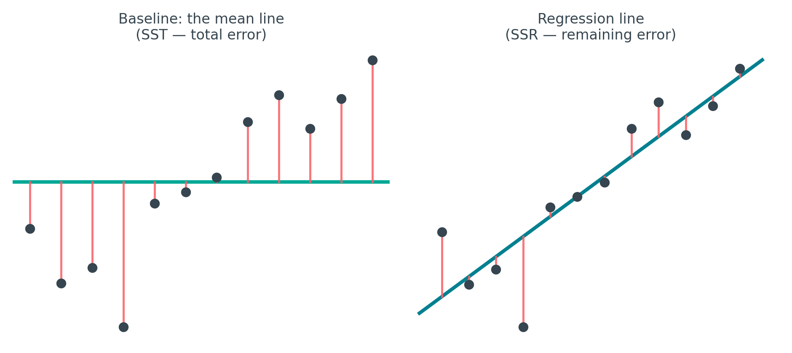
R²
R²: Compare Against the Simplest Possible Guess
Imagine you had no CGPA column at all — just the package numbers. What's the best prediction you could make for any new student?
The answer: predict the mean
With no input to work from, always guessing ȳ (the average package) is the best you can do — this is the mean line, our baseline.
R² measures how much better your regression line performs than this mean-only baseline.
Regression Metrics — MAE · MSE · RMSE · R² · Adjusted R²
14

Slide 15
R²
The R² Formula: SSR vs. SST
Formalize both lines' total error, then compare them as a ratio:
SSR
SST
Σ(yᵢ − ŷᵢ)²
Σ(yᵢ − ȳ)²
Sum of Squared Residuals — how much your regression line still misses by
Sum of Squares Total — how much the mean line misses by (the baseline mistake)
R² = 1 − SSR / SST
If your regression line makes far less total error than the mean line, SSR is small relative to SST, so SSR/SST is small, and R² sits close to 1 — a good sign.
Regression Metrics — MAE · MSE · RMSE · R² · Adjusted R²
15

Slide 16
R²
Reading the R² Value
R² = 1
SSR = 0 — the regression line makes zero error, passing exactly through every point. Only possible with perfectly linear data.
R² = 0
SSR = SST — your regression line does exactly as well as just guessing the mean every time. The input feature added no value at all.
R² < 0
SSR > SST — the regression line is actually worse than the mean baseline. This is a real warning sign, not a bug.
When can R² go negative? Typically when the wrong kind of model is applied to the data — for example, fitting a straight line to data that's fundamentally non-linear.
Regression Metrics — MAE · MSE · RMSE · R² · Adjusted R²
16

Slide 17
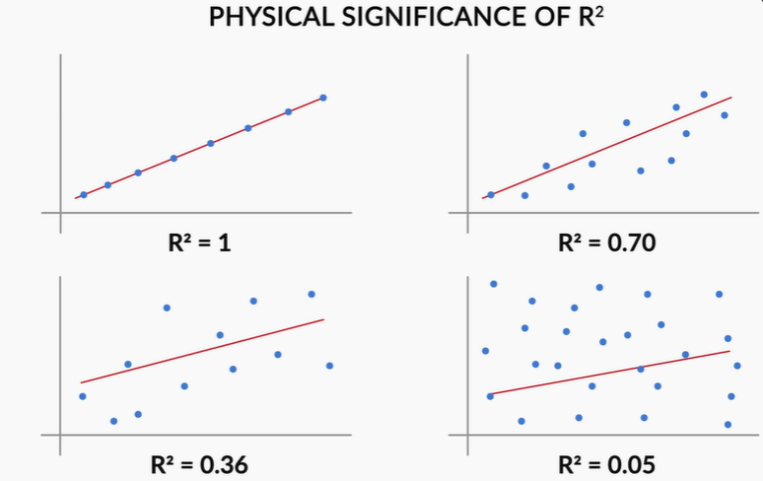

Slide 18
R²
A Second Reading: "% of Variance Explained"
Package numbers vary a lot across students — some get 1.5 LPA, others 4.5 LPA. R² tells you how much of that spread your input columns can account for.
R² = 0.80 (or 80%)
means: 80% of the variation in package can be explained by CGPA. The remaining 20% comes from factors not captured in this model.
Extend the example: add IQ alongside CGPA as inputs, and R² might reach 0.80 using both together. The remaining 20% could be things a spreadsheet can't measure — interview performance on the day, general attitude, or other unrecorded factors.
Important: whether 0.80 counts as "good" still depends on the domain. Physical sciences often expect R² above 0.95; social or behavioral data is often considered strong at 0.6–0.8.
Regression Metrics — MAE · MSE · RMSE · R² · Adjusted R²
17

Slide 19
THE CATCH
R²'s Flaw: It Never Wants to Go Down
Add any new input column — useful or not — and R² will stay the same or increase. It can never decrease from adding a column.
A useful column: IQ
An irrelevant column: temperature
Makes sense — IQ plausibly relates to package. R² rising here reflects real, useful predictive power.
The temperature on a student's interview day shouldn't affect package at all — yet adding it as a column still won't decrease R², and it can even push R² up slightly by chance.
This is misleading: a rising R² starts to look like "the model improved," when really you've just given it more room to fit noise. We need a version of R² that penalizes this.
Regression Metrics — MAE · MSE · RMSE · R² · Adjusted R²
18

Slide 20
ADJUSTED R²
Adjusted R²: Penalizing Useless Columns
Same starting point as R², with a correction factor built around two new quantities:
Adjusted R² = 1 − [ (1 − R²)(n − 1) / (n − k − 1) ]
n
k
Number of rows — how many data points (students) you have
Number of independent columns — how many input features you're using
The whole design of this formula is built to punish adding a column that doesn't earn its keep — we'll trace through exactly how, on the next two slides.
Regression Metrics — MAE · MSE · RMSE · R² · Adjusted R²
19

Slide 21
Adjusted R² = 1 − [ (1 − R²)(n − 1) / (n − k − 1) ]
ADJUSTED R²
Case 1: Adding a Useless Column
Trace the formula step by step when k increases but the new column adds nothing meaningful:
1
k increases by 1
n − k − 1 gets smaller, since k is subtracted
2
(n−1)/(n−k−1) increases
A smaller denominator makes this fraction bigger
3
R² barely changes
An irrelevant column can't meaningfully reduce SSR, so (1 − R²) stays about the same
4
The whole penalty term grows
(1 − R²) × (n−1)/(n−k−1) increases, since the second factor grew
5
Adjusted R² goes down
1 − (a bigger number) is smaller than before
Net effect: raw R² stays flat or nudges up — but Adjusted R² drops, correctly flagging the useless column.
Regression Metrics — MAE · MSE · RMSE · R² · Adjusted R²
20

Slide 22
Adjusted R² = 1 − [ (1 − R²)(n − 1) / (n − k − 1) ]
ADJUSTED R²
Case 2: Adding a Meaningful Column
Now trace the same formula when the new column genuinely helps predict the output:
1
k increases by 1
Same as before — n − k − 1 shrinks, so (n−1)/(n−k−1) grows
2
R² increases meaningfully
A useful column reduces SSR by a real amount this time
3
(1 − R²) shrinks noticeably
Since R² rose significantly, this factor drops faster than the ratio grew
4
The penalty term shrinks overall
The drop in (1 − R²) outweighs the rise in (n−1)/(n−k−1)
5
Adjusted R² goes up
1 − (a smaller number) is bigger than before
Net effect: both raw R² and Adjusted R² increase — correctly rewarding a genuinely useful feature.
Regression Metrics — MAE · MSE · RMSE · R² · Adjusted R²
21

Slide 23
GUIDANCE
Which Metric Should You Trust?
•
Start with all five
For any new dataset or problem, calculate MAE, MSE, RMSE, R², and Adjusted R² together before drawing conclusions.
•
Use R² and Adjusted R² together
Always compute both — never just one — especially once you move to Multiple Linear Regression with several input columns.
•
Watch the gap between them
If R² and Adjusted R² are close, your features are pulling their weight. A large gap is a red flag that some columns are just adding noise.
•
For training, pick one loss function
MSE is the practical default when you need a single differentiable function for Gradient Descent to optimize.
Regression Metrics — MAE · MSE · RMSE · R² · Adjusted R²
22

Slide 24
IMPLEMENTATION
Setting Up: A Trained Model, Ready to Score
Same placement dataset and Simple Linear Regression model from earlier — already fit, with predictions ready on the test set.
from sklearn.linear_model import LinearRegression
from sklearn.model_selection import train_test_split
X_train, X_test, y_train, y_test = train_test_split(
X, y, test_size=0.2, random_state=2
)
lr = LinearRegression()
lr.fit(X_train, y_train)
y_pred = lr.predict(X_test)
Every metric from here on needs just two arrays: y_test (actual) and y_pred (predicted).
Regression Metrics — MAE · MSE · RMSE · R² · Adjusted R²
23

Slide 25
IMPLEMENTATION
Computing MAE, MSE, and RMSE
scikit-learn provides direct functions for MAE and MSE. RMSE has no dedicated function — just take the square root of MSE yourself.
from sklearn.metrics import mean_absolute_error, mean_squared_error
import numpy as np
mae = mean_absolute_error(y_test, y_pred)
mse = mean_squared_error(y_test, y_pred)
rmse = np.sqrt(mse)
print(mae, mse, rmse)
No built-in RMSE function: this is deliberate — since RMSE is just √MSE, scikit-learn expects you to compute mean_squared_error() and wrap it in np.sqrt() yourself.
Regression Metrics — MAE · MSE · RMSE · R² · Adjusted R²
24

Slide 26
IMPLEMENTATION
Computing R² and Reading the Result
from sklearn.metrics import r2_score
r2 = r2_score(y_test, y_pred)
print(r2) # e.g. 0.78
Reading r2 ≈ 0.78
Not perfect, but solidly decent — roughly 78% of the variation in package is explained by CGPA alone. The regression line is meaningfully better than just guessing the mean package for everyone.
With only one input feature (CGPA), we'd expect Adjusted R² to sit very close to this raw R² — let's confirm that next.
Regression Metrics — MAE · MSE · RMSE · R² · Adjusted R²
25

Slide 27
IMPLEMENTATION
Computing Adjusted R² — No Built-in Function
Unlike the others, scikit-learn has no adjusted_r2_score() — implement the formula directly:
n = X_test.shape[0] # number of rows
k = X_test.shape[1] # number of input columns
adjusted_r2 = 1 - ((1 - r2) * (n - 1)) / (n - k - 1)
print(adjusted_r2) # e.g. 0.77
With k = 1 (only CGPA as input), Adjusted R² comes out very close to raw R² — exactly as expected, since the correction factor is mild when there's just one feature.
The gap between R² and Adjusted R² only becomes noticeable once you start adding more input columns — which is exactly what we test next.
Regression Metrics — MAE · MSE · RMSE · R² · Adjusted R²
26

Slide 28
LIVE DEMO
Demo 1: Adding a Random, Useless Column
Add a column of random numbers — nothing tying it to package — refit, and compare both scores before and after.
df['random'] = np.random.random(df.shape[0])
X = df[['cgpa', 'random']]
# refit LinearRegression, recompute r2 and adjusted_r2
R²
Adjusted R²
0.78 → 0.81
0.77 → 0.76
Ticks up slightly — R² can't tell the new column is meaningless
Drops — correctly penalizing a column that adds nothing real
Regression Metrics — MAE · MSE · RMSE · R² · Adjusted R²
27

Slide 29
LIVE DEMO
Demo 2: Adding a Genuinely Useful Column
Now add a feature that's actually correlated with package (simulating something like an aptitude score) — refit again.
# a feature that genuinely correlates with package
X = df[['cgpa', 'aptitude_score']]
# refit LinearRegression, recompute r2 and adjusted_r2
R²
Adjusted R²
0.78 → 0.85
0.77 → 0.84
Jumps up meaningfully — real predictive power was added
Rises too — the model genuinely improved, and Adjusted R² agrees
Regression Metrics — MAE · MSE · RMSE · R² · Adjusted R²
28

Slide 30
KEY TAKEAWAYS
Five Metrics, One Complete Picture
MAE
Average absolute error — interpretable, robust, but not differentiable at zero.
MSE
Average squared error — differentiable (used as a loss function), but hard to interpret and outlier-sensitive.
RMSE
√MSE — the practical favorite, combining differentiability with real units.
R²
How much better than the mean baseline — context-independent, but always rises as columns are added.
Adjusted R²
R² corrected for feature count — penalizes useless columns, rewards genuinely useful ones.
Practice challenge: pick any regression project, apply Simple or Multiple Linear Regression, and calculate all five metrics yourself.

